Slide 1
AGILE DEVELOPMENT
Rabindra Bista, PhD
Dept. of CSE
Kathmandu University
December 06, 2021

Slide 2
Contents
Software Engineering
What is an Agile Development?
What is Agility?
Agility and Cost of Change
What is an Agile Process?
Agility Principles
Human Factors

Slide 3
Contents
Extreme Programming (XP)
Industrial Extreme Programming (IXP)
Scrum

Slide 4
Software Engineering
Software engineering defined as “ the establishment and use of sound engineering principles in order to obtain economically developed software that is reliable and worked efficiently on real machines”

Slide 5
What is an Agile Development?
Philosophy + A set of Development Guidelines
Philosophy encourages
  Customer satisfaction and early delivery of s/w
  Small highly motivated project teams
  Informal methods
  Minimal software engineering work products
  Overall development simplicity
Development Guidelines stresses
  Delivery over analysis and design
  Active and continuous communication between developers and customers

Slide 6
What is Agility?
An effective response to change
  s/w, team members, new technology etc.
Encourages team structures and attitudes that make communication more simple
Rapid delivery of operational s/w
  Emphasizing incremental delivery strategy
Adopts the customer as a part of the development
Recognizes a project plan must be flexible
Focuses on the most essential work products

Slide 7
Agility and the Cost of Change
In the conventional way of s/w development
  First, the cost of change increases nonlinearly as a project progress
    Early requirement gathering and the cost is minimal
  Then the cost escalate quickly when major changes require in the middle or final stage of project development phases

Slide 8
Agility and the Cost of Change
In Agile development
  A significant reduction in he cost of change can be achieved
    Incremental delivery is coupled with other agile practices
      Continuous unit testing, pair programming and so on

Slide 9
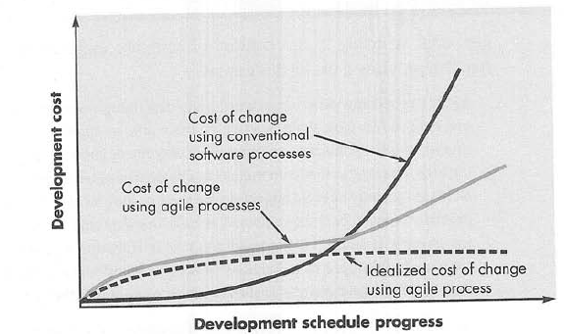
Agility and the Cost of Change
Fig. 1: Change cost as a function of time in development

Slide 10
What is an Agile Process?
Unpredictability
  Analysis
  Design
  Construction
  Testing
Requirements and their priorities
How much design is necessary before construction?

Slide 11
What is an Agile Process?
How do we create a process that can manage unpredictability?
  Process adaptability
    Incremental adaptation
      Based on customers’ feedbacks on operational prototype
    Adaptation must keep pace with change
  S/W increments must be delivered in short time periods

Slide 12
What is an Agile Process?
An agile process can be defined as an iterative approach enabling the customer to evaluate the software increment regularly, provide necessary feedback to the software team, and influence the process adaptations that are made to accommodate the feedback

Slide 13
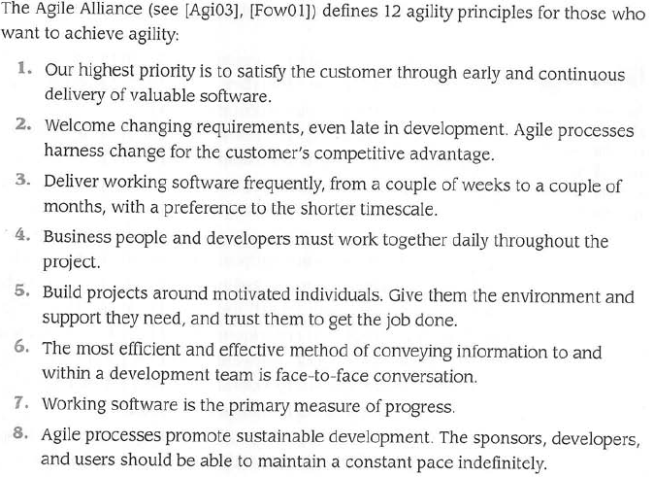
Agility Principles

Slide 14
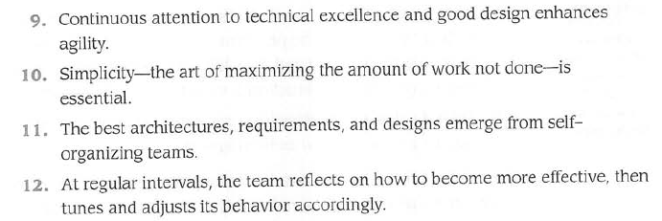
Agility Principles

Slide 15
The Politics of Agile Development
Debate on benefits and applicability of Agile Software Development over Traditional Software Development
What is the best way to achieve agility?
Consider the best of both approaches

Slide 16
Human Factors
Agile development focuses on the talents and skills of individuals, molding the process to specific people and teams
Key traits of people on a agile team and the team itself:
  Competence:
    innate talent, specific s/w related skills and the overall knowledge of the process
  Common Focus:
    all should be focused on one goal-
      to deliver a working s/w increment to the customers within the time promised
  Collaboration:
    team members must collaborate with one another and all other stakeholders

Slide 17
Human Factors
  Decision making ability:
    team is given autonomy- decision making authority for both technical and project issues
    allowed freedom to control its own destiny
  Fuzzy problem solving ability:
    lesson learned from any problem solving activity may be of benefit to the team later in the project

Slide 18
Human Factors
  Mutual trust and respect:
    jelled team (strongly knit team members)
    Whole is greater than the sum of he parts
  Self-organization:
    The agile team organizes
      Itself for the work to be done
      The process to best accommodate its local environment
      The work schedule to best achieve delivery of the software increment

Slide 19
Extreme Programming (XP)
The most widely used approach to agile S/W development
XP Values: a set of five values
  Communication, Simplicity, Feedback, Courage and Respect
    Are used as a driver for specific XP activities, actions and tasks

Slide 20
Extreme Programming (XP) (Contd…)
Communication:
  XP emphasizes to establish effective metaphors (story or use case) for communication so that s/w engineers and other stakeholders know how the system works
Simplicity:
  Designers are encouraged to design a part of s/w (fraction) only for immediate needs not for he whole system at a time

Slide 21
Extreme Programming (XP) (Contd…)
Feedback: three sources feedback
  Implemented s/w itself, the customer and other s/w team members
Effective testing strategy (unit testing), incremental development -> iterative planning
The team provides the customer with rapid feedback in terms of cost and schedule impact

Slide 22
Extreme Programming (XP) (Contd…)
Courage/ Discipline:
  Design for today not for tomorrow because future requirement may change dramatically
Respect:
  Among team members, between other stakeholders and the team members, and software itself
    Grows respect for the XP process

Slide 23
Extreme Programming (XP) (Contd…)
The XP Process:
Used an object-oriented approach
Object Oriented = Objects + Classification (sub-class, super class) + Inheritance + Communication
Four key framework activities:
  Planning, Design, Coding and Testing

Slide 24
Extreme Programming (XP) (Contd…)
Planning or Planning Game:
  Listening to understand the business context for the s/w
  Create stories (users’ stories)
    Describes required out put, major features and functionalities to be built
    Customer assigns a value (for priority) to the story
  The XP team members assign a cost (development week) to the story

Slide 25
Extreme Programming (XP) (Contd…)
    Story > 3 weeks -> customer splits the story into smaller stories -> reassign value and cost
    Commitment for a release : three options
      All stories will be implemented immediately
      Stories with the highest value, first
      The riskiest stories, first
  Release first s/w increment
  Team members calculates project velocity
    The no. of customer stories implemented during the first release
      Useful for further planning

Slide 26
Extreme Programming (XP) (Contd…)
Design:
  Data , architecture, components and interfaces
  Follows KIS (keep it simple) principle
  Provides implementation guidelines
  Use of CRC (Class-Responsibility-Collaboration) cards
    Are design work product
    Identify and organize the classes (object oriented) that are relevant to system or product requirement

Slide 27
Extreme Programming (XP) (Contd…)
  Spike solution: the design prototype is implemented and evaluate for a story which occurs as a difficult design problem
  Refactoring: Cleaning up Code
    Design occurs continuously as the system is constructed
Coding:
  First develop a series of unit tests for stories
    Better able to focus on what must be implemented to pass the test

Slide 28
Extreme Programming (XP) (Contd…)
  Code for the each of the stories
  Unit tested immediately
  Key concept is pair programming
    Two people work together at one computer to create code for a story
      Real time problem solving
      Real time quality assurance
  Continuous integration and smoke testing (for time critical projects)

Slide 29
Extreme Programming (XP) (Contd…)
Testing:
  Creation of unit tests before coding
  Implement the unit tests
  Encourages regression testing whenever code is modified:
    re-execution of some sub-set of tests that have already been conducted to avoid unintended side effects due to change

Slide 30
Extreme Programming (XP) (Contd…)
  Universal testing suite:
    individual unit tests are organized
  Integration and validation testing may occur on a day basis
  Acceptance tests ( customer tests)
    Derived from user stories

Slide 31
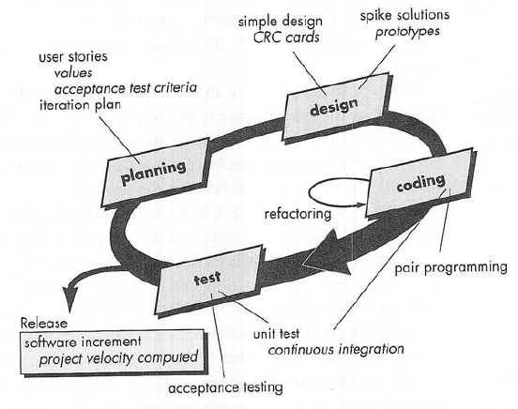
Fig 2:The Extreme Programming process

Slide 32
Industrial Extreme Programming (IXP)
Organic evolution of XP for large organizations
Imbued with XP’s minimalist, customer-centric, test-driven spirit
Greater inclusion of management, its expanded role for customers and its upgraded technical practices

Slide 33
Industrial Extreme Programming (IXP)
IXP incorporates six new practices
Readiness assessment:
  Existence of an appropriate development environment
  Team with proper set of stakeholders
  Distinct quality program and continuous improvement
  Support new values of an agile team by organizational culture
  populate broader project community

Slide 34
Industrial Extreme Programming (IXP)
Project Community:
  Morphing of a team into community
    Technologist, customers, other stakeholders
    The role of the community members must be explicitly defined
Project Chartering:
  IXP team examines
    Business justification for the project
    Over goals and objectives
    Context of the project

Slide 35
Industrial Extreme Programming (IXP)
Test-driven Management:
  Establishes a series of measurable destinations
  Defines mechanism for determining whether or not these destinations have been reached
Retrospectives:
  Conducts a specialized technical review after a s/w increment is delivered
  Examines issues, events and lesson-learned
Continuous Learning:
  Encourage to learn new methods and techniques

Slide 36
Industrial Extreme Programming (IXP)
Other practices in IXP:
  Story-driven development (SDD): Stories for acceptance test be written
  Domain-driven Design (DDD): Creation of domain model to represent how domain experts think about their subject
  Pairing: include mangers and other stakeholders
  Iterative usability: usability design evolves with software increments

Slide 37
The XP Debate
Codependent nature of XP practices are both its strength and weakness
Issues:
  Requirements volatility
  Conflicting customer needs
  Requirement are expressed informally
  Lack of formal design

Slide 38
Other Agile Process Models
Adaptive Software Development (ASD)
Scrum
Dynamic Systems Development Method (DSDM)
Crystal
Feature Driven Development (FDD)
Lean Software Development (LSD)
Agile Modeling (AM)
Agile Unified Process (AUP)

Slide 39
Scrum
For project with tight timelines, changing requirements, and business criticality
Five Framework activities:
  Requirement, Analysis, Design, Evolution, and Delivery
  By a team called Scrum Team
  Within each framework activity, work tasks occur within a process pattern called a Sprint
    A basic unit of development in scrum
  Higher the product complexity and size higher the number of sprints for each framework activity

Slide 40
Scrum
Development actions:
  Backlog:
    A prioritized list of high level project requirements or features which is changeable
    Product manager assesses the backlog and updates priorities
  Sprints:
    Work units to achieve a requirement defined in the backlog
    Must fit into a predefined time-box (30 days)
    Allows work in short-term with stable environment
      There is no change in the sprint level
      At the end, new functionality is demonstrated

Slide 41
Scrum
  Scrum Meetings:
    Team leader or the Scrum Master leads the meetings
    Daily 15 minutes meeting
    Uncover potential problems as soon as possible
    Includes three key questions
      What did you do since the last team meeting?
      What obstacles are you encountering?
      What do you plan to accomplish by the next team meeting?
  Demos:
    Deliver the s/w increment (functionality) to the customer for evaluation

Slide 42
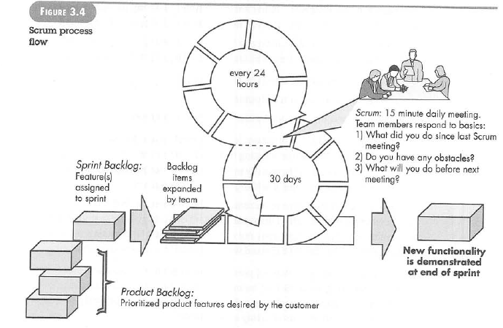
Scrum

